Slide 1
HTTP Requests, Forms and Session Handling
Presented by: Rishikesh Khodke
Authored by: Rishikesh Khodke

Slide 2
Course Structure
Target audience | Open for All
Level | Level 1
Pre-requisites | Basic knowledge of any programming language such as c or c++.
Training methods | PPT and Interaction with audience.
Evaluation | After completion of Training program,.

Slide 3
HTTP Requests, Forms and Session Handling
Copyright © 2019 Cybage Software Pvt. Ltd. All Rights Reserved. Cybage Confidential.
www.cybage.com

Slide 4
Agenda
What is HTTP Request?
HTML Form
Session Handling

Slide 5
HTTP Protocol
What is a protocol?
HTTP is a set of rules, which functions as a request-response protocol in the client-server computing model.
A web browser is the client.
Application running on a computer hosting a web site may be the server.
The client submits an HTTP request message, in a GET or POST or other format, to the server.
The server, which provides resources such as HTML files and other content, or performs other functions on behalf of the client, returns a response message to the client with a status code.
Response status Code
200 OK
404 Not Found
500 Internal Server Error
More @: http://en.wikipedia.org/wiki/List_of_HTTP_status_codes

Slide 6
What is HTTP Request?
HTTP Request is a packet of Information that one computer sends to another computer to communicate something. To its core, HTTP Request is a packet of binary data sent by the Client to server.
HTTP Request contains following parts
Request Line
Headers, 0 or more Headers in the request
An optional Body of the Request

Slide 7
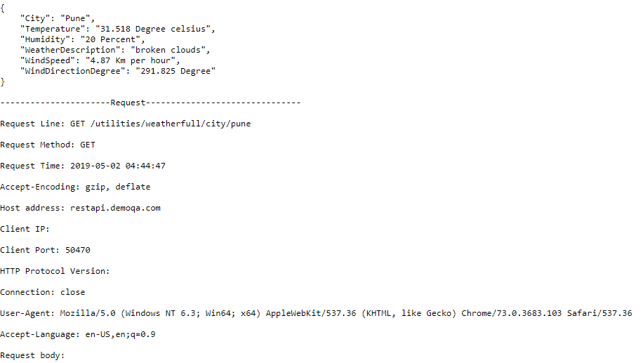
different parts of an HTTP Request
http://restapi.demoqa.com/utilities/weatherfull/city/pune
Request Line : A Request Line specifies
the Method Token (GET, PUT … )
followed by the Request URI and then
the HTTP Protocol that is being used.

Slide 8
different parts of an HTTP Request
http://restapi.demoqa.com/utilities/weatherfull/city/pune
Request Header :
A HTTP Request contains zero or more Request Headers. In the request section, whatever follows Request Line till before Request Body everything is a Header. Headers are used to pass additional information about the request to the server.

Slide 9
different parts of an HTTP Request
http://restapi.demoqa.com/utilities/weatherfull/city/pune
Request Body :
Request Body is the part of the HTTP Request where additional content can be sent to the server.

Slide 10
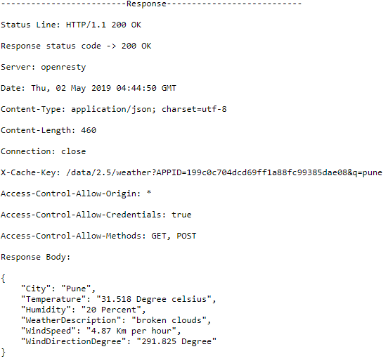
HTTP Response
http://restapi.demoqa.com/utilities/weatherfull/city/pune
The response contains status information about the request and may also contain the requested content.

Slide 11
$_SERVER
$_SERVER is an array containing information such as headers, paths, and script locations. The entries in this array are created by the web server.
$_SERVER parameters :
$_SERVER['PHP_SELF'] : The filename of the currently executing script, relative to the document root.
'SERVER_ADDR‘ : The IP address of the server under which the current script is executing.
'SERVER_NAME‘ : The name of the server host under which the current script is executing.
'REQUEST_METHOD‘ : Which request method was used to access the page; e.g. 'GET', 'HEAD', 'POST', 'PUT'.
'HTTP_HOST‘ : Contents of the Host: header from the current request, if there is one. 'REMOTE_ADDR‘ : The IP address from which the user is viewing the current page.
'REMOTE_HOST‘ : The Host name from which the user is viewing the current page.

Slide 12
$_SERVER
<?php $indicesServer = array('PHP_SELF', 'argv', 'argc', 'GATEWAY_INTERFACE', 'SERVER_ADDR', 'SERVER_NAME', 'SERVER_SOFTWARE', 'SERVER_PROTOCOL', 'REQUEST_METHOD', 'REQUEST_TIME', 'REQUEST_TIME_FLOAT', 'QUERY_STRING', 'DOCUMENT_ROOT', 'HTTP_ACCEPT', 'HTTP_ACCEPT_CHARSET', 'HTTP_ACCEPT_ENCODING', 'HTTP_ACCEPT_LANGUAGE', 'HTTP_CONNECTION', 'HTTP_HOST', 'HTTP_REFERER', 'HTTP_USER_AGENT', 'HTTPS', 'REMOTE_ADDR', 'REMOTE_HOST', 'REMOTE_PORT', 'REMOTE_USER', 'REDIRECT_REMOTE_USER', 'SCRIPT_FILENAME', 'SERVER_ADMIN', 'SERVER_PORT', 'SERVER_SIGNATURE', 'PATH_TRANSLATED', 'SCRIPT_NAME', 'REQUEST_URI', 'PHP_AUTH_DIGEST', 'PHP_AUTH_USER', 'PHP_AUTH_PW', 'AUTH_TYPE', 'PATH_INFO', 'ORIG_PATH_INFO') ; echo '<table cellpadding="10">' ; foreach ($indicesServer as $arg) { if (isset($_SERVER[$arg])) { echo '<tr><td>'.$arg.'</td><td>' . $_SERVER[$arg] . '</td></tr>' ; } else { echo '<tr><td>'.$arg.'</td><td>-</td></tr>' ; } } echo '</table>' ;
<?php echo $_SERVER['SERVER_NAME']; ?>

Slide 13
HTTP Methods : GET
GET is used to request data from a specified resource.
url/?variable=value&variable=value
GET requests can be cached
GET requests remain in the browser history
GET requests can be bookmarked
GET requests should never be used when dealing with sensitive data
GET requests have length restrictions
GET requests is only used to request data (not modify)

Slide 14
HTTP Methods : POST
POST is used to send data to a server to create/update a resource.
The data sent to the server with POST is stored in the request body of the HTTP request:
POST requests:
POST requests are never cached
POST requests do not remain in the browser history
POST requests cannot be bookmarked
POST requests have no restrictions on data length

Slide 15
PHP Form Handling : GET
<html> <body> <form action="welcome_get.php" method="get"> Name: <input type="text" name="name"><br> E-mail: <input type="text" name="email"><br> <input type="submit"> </form> </body> </html>
<html> <body> Welcome <?php echo $_GET["name"]; ?><br> Your email address is: <?php echo $_GET["email"]; ?> </body> </html>

Slide 16
PHP Form Handling : POST
<html> <body> <form action="welcome.php" method="post"> Name: <input type="text" name="name"><br> E-mail: <input type="text" name="email"><br> <input type="submit"> </form> </body> </html>
<html> <body> Welcome <?php echo $_POST["name"]; ?><br> Your email address is: <?php echo $_POST["email"]; ?> </body> </html>

Slide 17
PHP Form Validation
Text Fields : E-mail: <input type="text" name="email">
Text Area : Comment: <textarea name="comment" rows="5" cols="40"></textarea>
Radio Button : Above 18 ? <input type="radio" name=“above18" value=“Y">Yes <input type="radio" name=“above18" value=“N">No
The Form Element : <form method="post" action="<?php echo htmlspecialchars($_SERVER["PHP_SELF"]);?>">
Button : submit , reset , button
<input type=“Submit” name=“submit” value=“add”>
Password : <input type=“password” name=“pass”>

Slide 18
PHP Form Validation
<?php // define variables and set to empty values $name = $email = $gender = $comment = $website = ""; if ($_SERVER["REQUEST_METHOD"] == "POST") { $name = test_input($_POST["name"]); $email = test_input($_POST["email"]); $website = test_input($_POST["website"]); $comment = test_input($_POST["comment"]); $gender = test_input($_POST["gender"]); } function test_input($data) { $data = trim($data); $data = stripslashes($data); $data = htmlspecialchars($data); return $data; } ?>

Slide 19
PHP Form Required Fields
<form method="post" action="<?php echo htmlspecialchars($_SERVER["PHP_SELF"]);?>">
Name: <input type="text" name="name">
<span class="error">* <?php echo $nameErr;?></span>
<br><br>
E-mail:
<input type="text" name="email">
<span class="error">* <?php echo $emailErr;?></span>
<br><br>
<input type="submit" name="submit" value="Submit">
</form>

Slide 20
PHP Form Required Fields
<?php
// define variables and set to empty values
$nameErr = $emailErr = $genderErr = $websiteErr = "";
$name = $email = $gender = $comment = $website = "";
if ($_SERVER["REQUEST_METHOD"] == "POST") {
if (empty($_POST["name"])) {
$nameErr = "Name is required";
} else {
$name = test_input($_POST["name"]);
}
if (empty($_POST["email"])) {
$emailErr = "Email is required";
} else {
$email = test_input($_POST["email"]);
}
?>

Slide 21
PHP Form Required Fields
$email = test_input($_POST["email"]); if (!filter_var($email, FILTER_VALIDATE_EMAIL)) { $emailErr = "Invalid email format"; }
$name = test_input($_POST["name"]); if (!preg_match("/^[a-zA-Z ]*$/",$name)) { $nameErr = "Only letters and white space allowed"; }

Slide 22
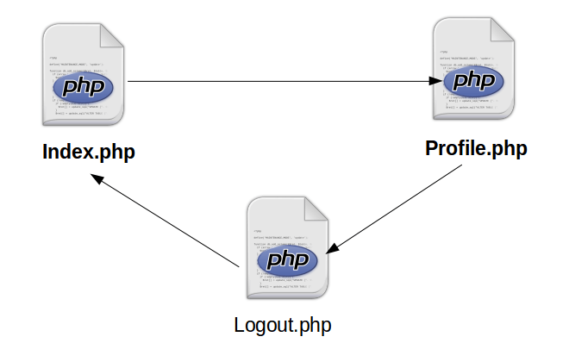
PHP Sessions
A session is a way to store information (in variables) to be used across multiple pages. Unlike a cookie, the information is not stored on the users computer.

Slide 23
Start a PHP Session
A session is started with the session_start() function. Session variables are set with the PHP global variable: $_SESSION.
<?php // Start the session session_start(); ?> <!DOCTYPE html> <html> <body> <?php // Set session variables $_SESSION["favcolor"] = "green"; $_SESSION["favanimal"] = "cat"; echo "Session variables are set."; ?> </body> </html>
<?php session_start(); ?> <!DOCTYPE html> <html> <body> <?php // Echo session variables that were set on previous page echo "Favorite color is " . $_SESSION["favcolor"] . ".<br>"; echo "Favorite animal is " . $_SESSION["favanimal"] . "."; ?> </body> </html>

Slide 24
Modify a PHP Session Variable
A session is started with the session_start() function. Session variables are set with the PHP global variable: $_SESSION.
<?php session_start(); ?> <!DOCTYPE html> <html> <body> <?php // to change a session variable, just overwrite it $_SESSION["favcolor"] = "yellow"; print_r($_SESSION); ?> </body> </html>

Slide 25
Destroy a PHP Session
To remove all global session variables and destroy the session, use session_unset() and session_destroy():
<?php session_start(); ?> <!DOCTYPE html> <html> <body> <?php // remove all session variables session_unset(); // destroy the session session_destroy(); ?> </body> </html>

Slide 26
PHP Session : Login Page
<?php if(isset($_POST['user_name'])) { session_start(); $_SESSION['name']=$_POST['user_name']; //Storing the name of user in SESSION variable. header("location: profile.php"); } ?> <html> <head> <title>Session Handling in PHP - CodeforGeek Demo's</title> </head> <body> <form action="" method="post" id="main_form"> <input type="text" name="user_name" size="40"><br /> <input type="submit" value="Log in"> </form><br><br> </body> </html>

Slide 27
PHP Session : profile Page
<?php session_start(); if(!isset($_SESSION['name'])) { header("location: index.php"); } $name=$_SESSION['name']; ?> <html> <head> <title>Profile of <?php echo $name;?></title> </head> <h1>Hello <?php echo $name;?></h1> <h3><a href="logout.php">Click here to log out</a></h3> </html>

Slide 28
PHP Session : logout Page
<?php if(isset($_SESSION['name'])) { unset($_SESSION['name']);
// remove all session variables
session_unset();
// destroy the session
session_destroy();
} echo '<h1>You have been successfully logout</h1>'; ?>

Slide 29


Copyright © 2019 Cybage Software Pvt. Ltd. All Rights Reserved. Cybage Confidential.
www.cybage.com

Slide 30

Thank You!
11/11/2019
www.cybage.com
Copyright © 2019 Cybage Software Pvt. Ltd. All Rights Reserved. Cybage Confidential.

